Slide 1

Skyward
Your skyway
Book Flights both national & internation

Slide 2
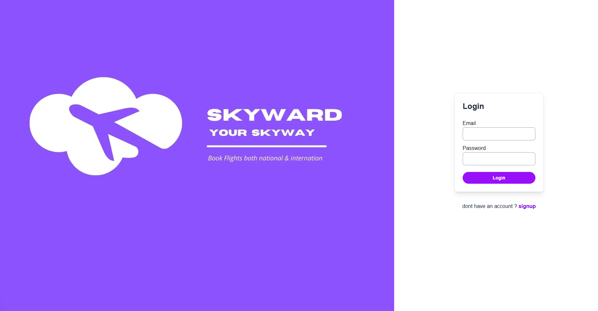

Slide 3
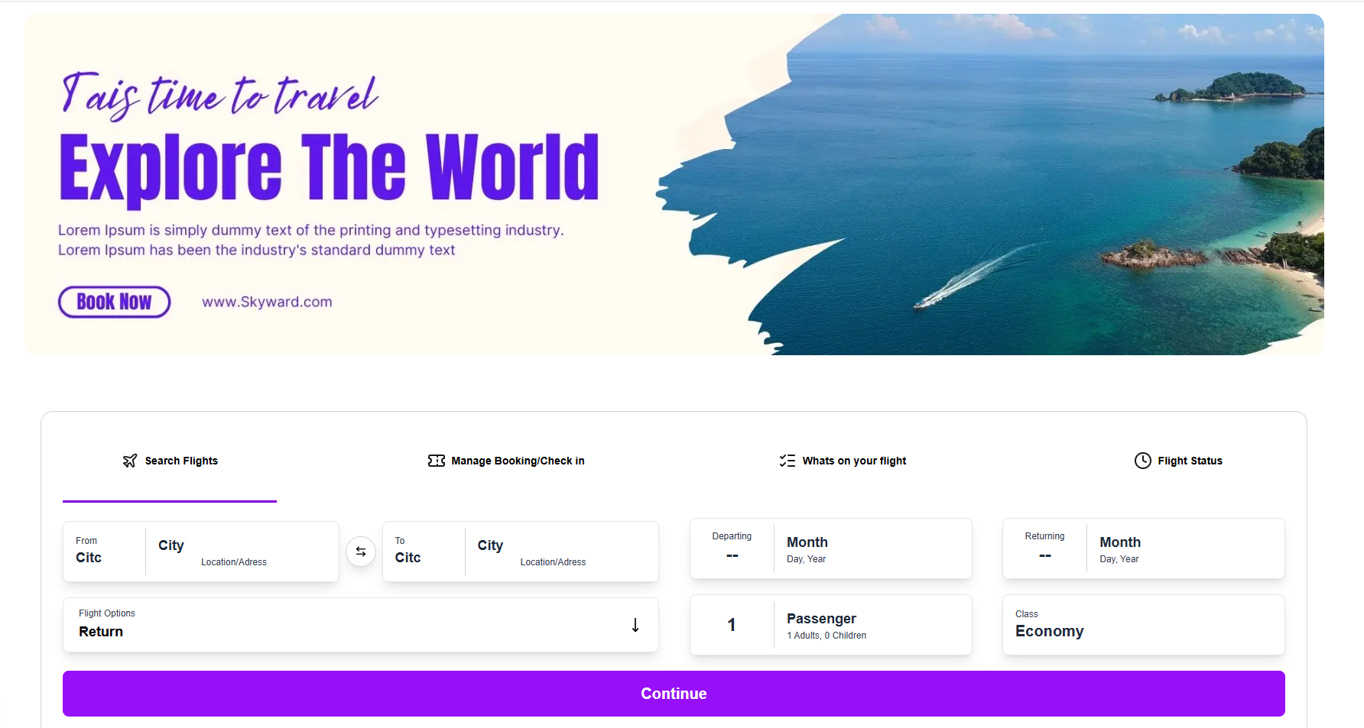

Slide 4
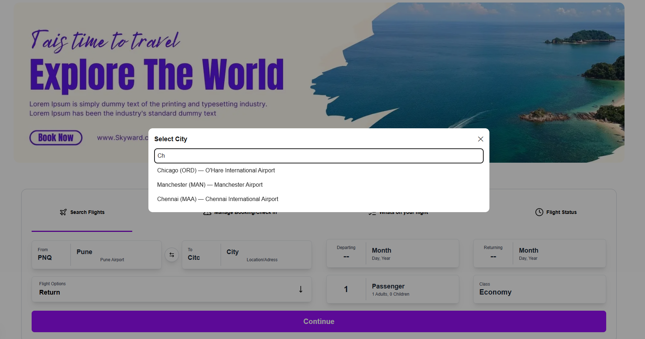

Slide 5
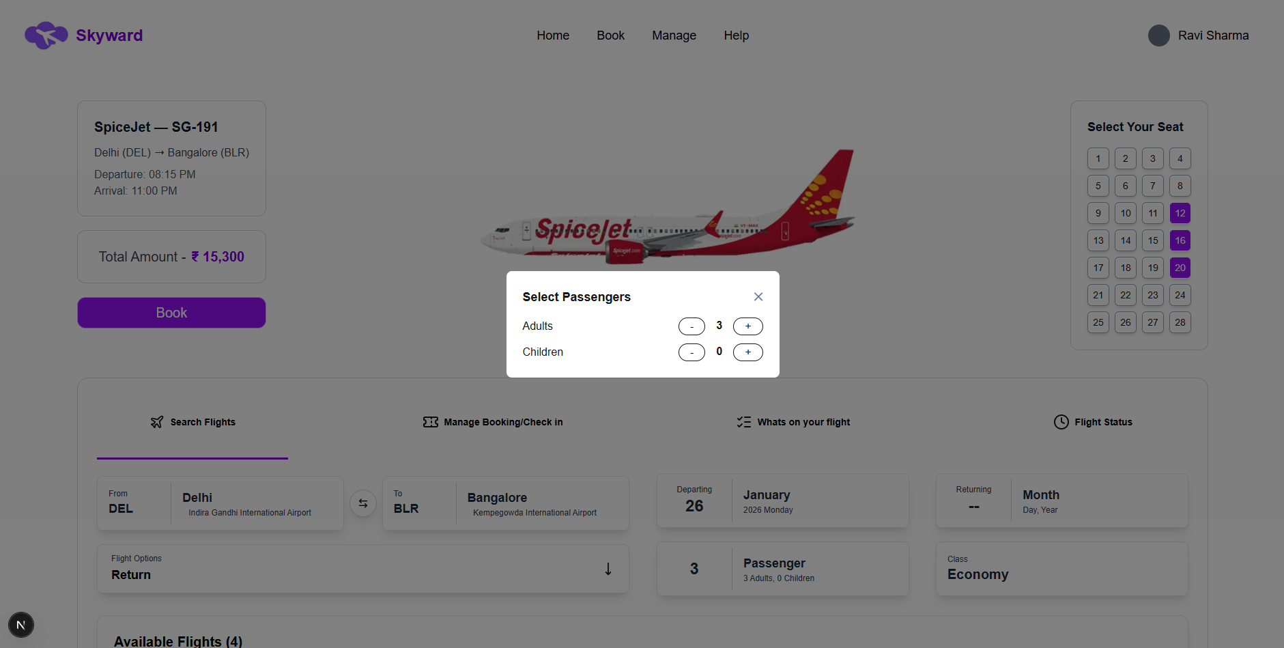

Slide 6
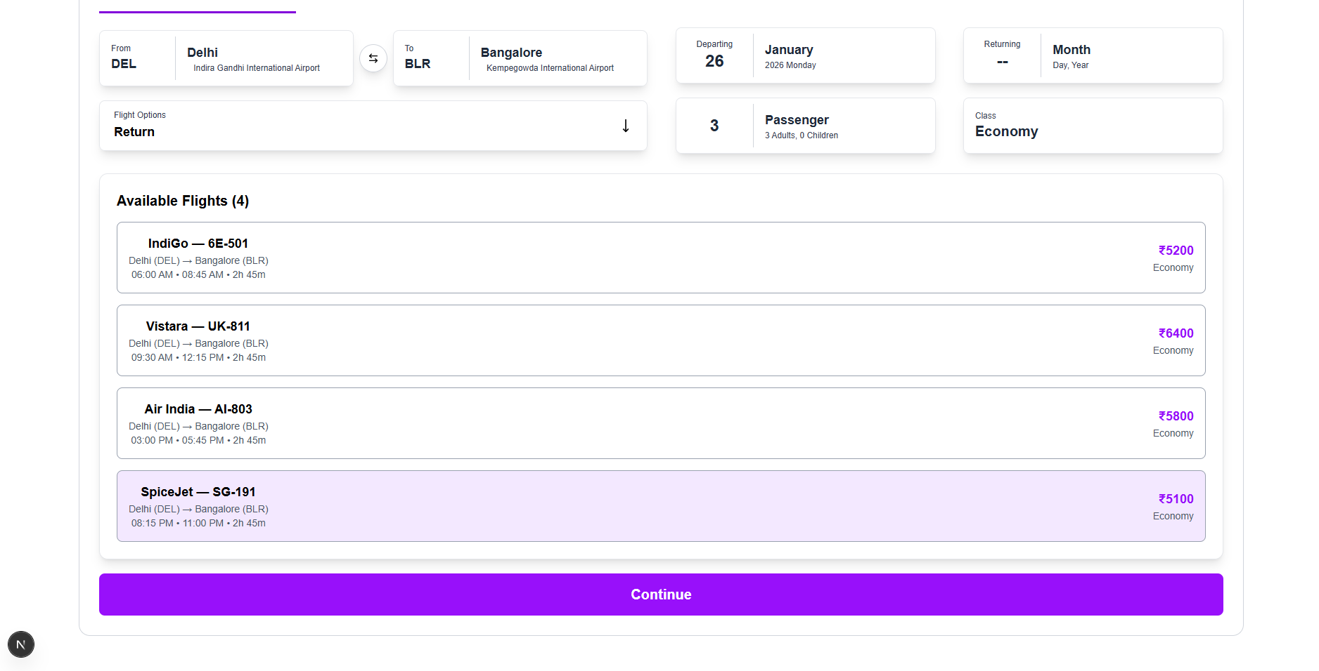

Slide 7


Slide 8
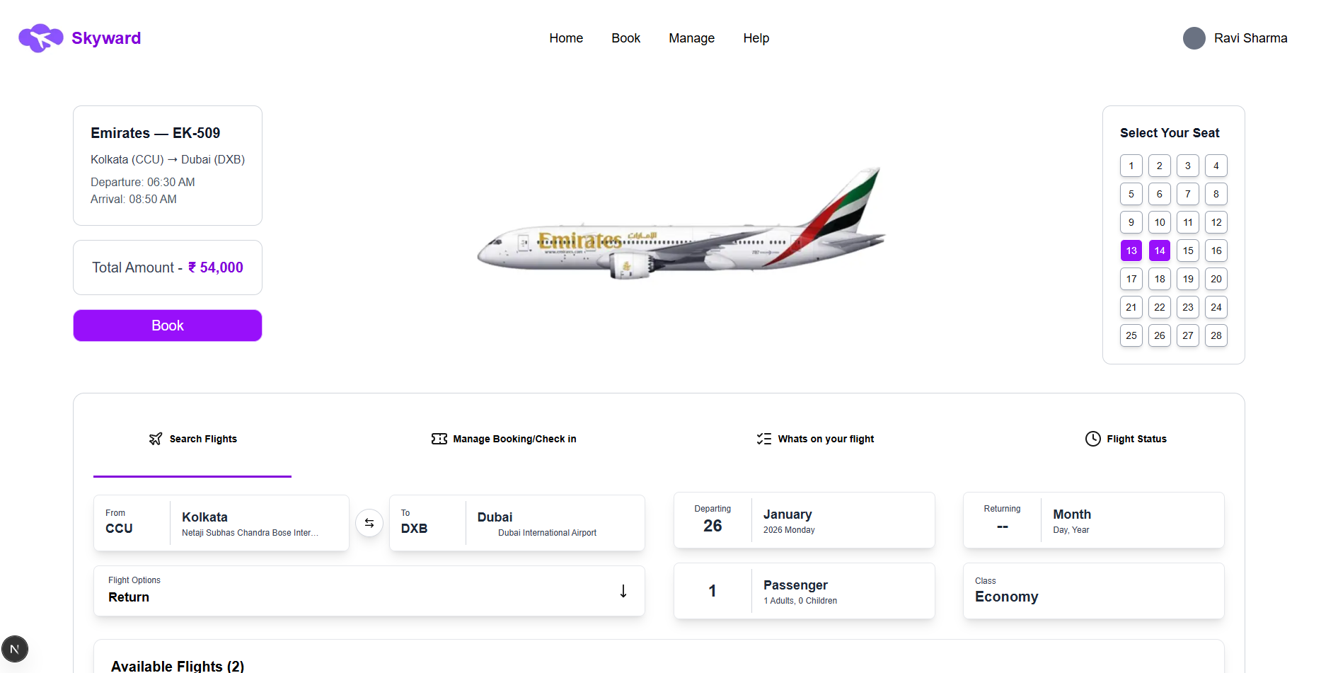

Slide 9
Skyward
Your skyway
Book Flights both national & internation
Skyward is a modern airline ticket reservation platform designed to deliver a seamless and intuitive flight booking experience. Users can securely create accounts, search flights by origin and destination, compare options, and select seats in real time. With clear pricing, aircraft details, class selection, and passenger management, Skyward ensures transparency and ease throughout the booking process. Confirmed reservations are securely stored within the user account, making Skyward a reliable and user-centric solution for smart air travel planning.

